Slide 1
Operator Overloading
and Type Conversions

Slide 2
INTRODUCTION
The utility of operators such as +, =, *, /, >, <, and so on is predefined in any programming language.
Programmers can use them directly on built-in data types to write their programs.
However, these operators do not work for user-defined types such as objects.
Therefore, C++ allows programmers to redefine the meaning of operators or giving extra functionality when they operate on class objects.
This feature is called operator overloading

Slide 3
Another Form of Polymorphism
Like function overloading, operator overloading is also a form of compile time polymorphism.
Operator overloading is, therefore, less commonly known as operator adhoc polymorphism .
Since different operators have different implementations depending on their arguments.
Operator overloading is generally defined by the language, the programmer, or both.

Slide 4
Another Form of Polymorphism
C++ tries to make the user defined data type behave in much the same way as the built-in-types.
For instance, C++ permits us to add two variables of user defined types with the same syntax that is applied to the basic types.
We can overload ( give additional meaning to) all the C++ operators except scope resolution, sizeof, conditional and class member access operators

Slide 5
Advantages
Operator overloading enables programmers to use notation closer to the target domain.
For example, to add two matrices, we can simply write M1 + M2 , rather than writing M1.add(M2).
With operator overloading, a similar level of syntactic support is provided to user-defined types as provided to the built-in types.
Operator overloading provides similar syntactic support of built-in types to user-defined types

Slide 6
Advantages
In scientific computing where computational representation of mathematical objects is required, operator overloading provides great ease to understand the concept.
Operator overloading makes the program clear.
For example, the statement div(mul(M1, M2), add(M1,M2)); can be better written as M1 * M2 / M1+M2

Slide 7
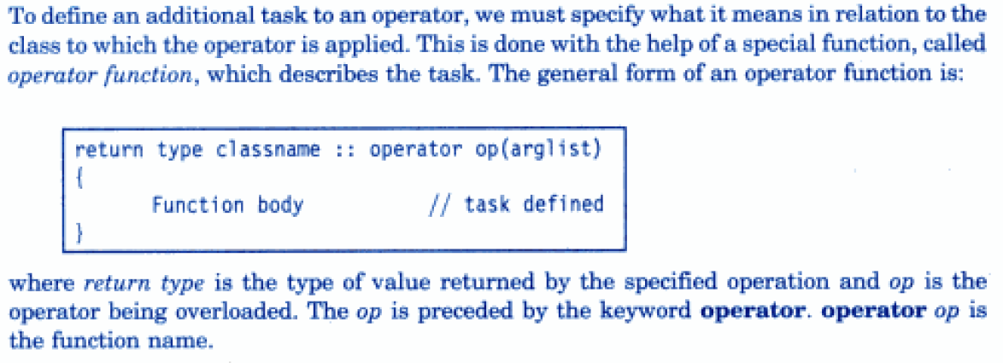
Important

Slide 8
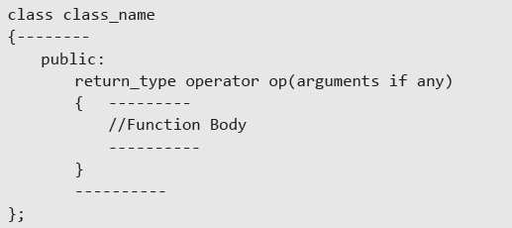
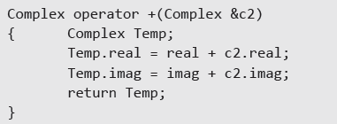
SYNTAX

Slide 9
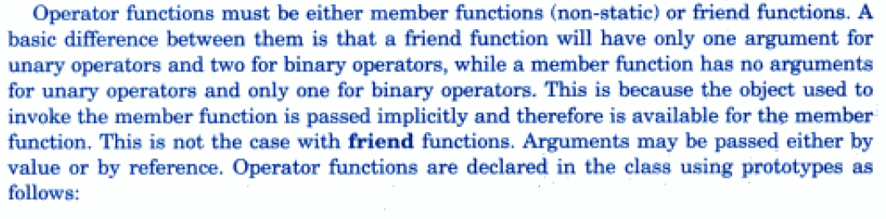
Important

Slide 10
OPERATORS THAT CAN AND CANNOT BE OVERLOADED
The exceptional operators that cannot be overloaded are as follows:
Scope resolution operator (::)
Member selection operator (.)
Member selection through a pointer to a function (.*)
Ternary operator (?:)

Slide 11
Important Points
Operator overloading cannot change the operation performed by an operator.
The two operators—the assignment operator (=) and the address operator (&) —need not be overloaded.
Operator overloading cannot alter the precedence and the associativity of operators.
New operators such as like **, <>, |&, and so on cannot be created.

Slide 12
Important Points
When operators such as &&, ||, and, are overloaded, they lose their special properties of short-circuit evaluation and sequencing.
Overloaded operators cannot have default arguments.
All overloaded operators except the assignment operator are inherited by derived classes.
Number of operands cannot be changed.
Overloading an operator that is not associated with the scope of a class is not permissible.

Slide 13
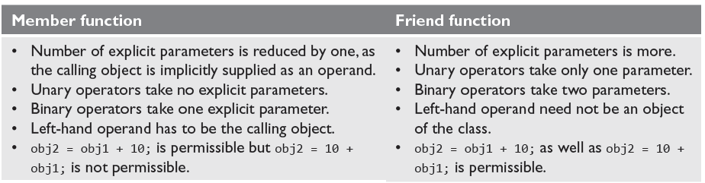
IMPLEMENTING OPERATOR OVERLOADING

Slide 14

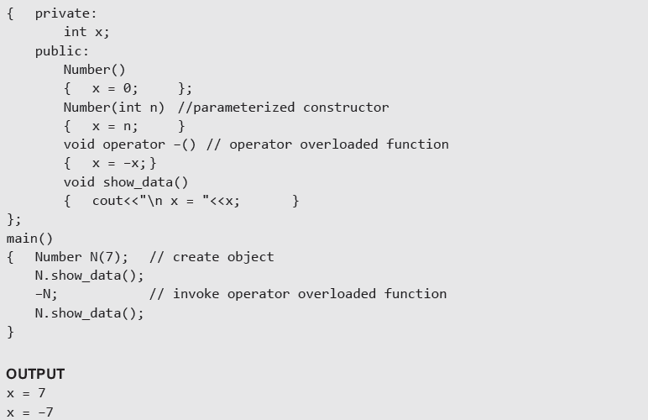
Using a member function to overload Unary Operator

Slide 15
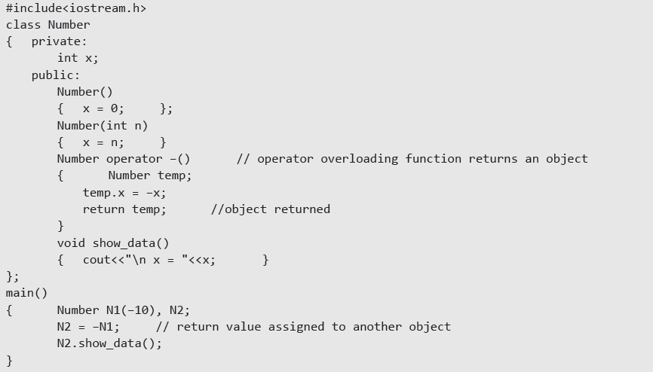
Returning Object

Slide 16
Using a Friend Function to Overload a Unary Operator
The function will take one operand as an argument.
This operand will be an object of the class.
The function will use the private members of the class only with the object name.
The function may take the object by using value or by reference.
The function may or may not return any value.
The friend function does not have access to the this pointer.

Slide 17
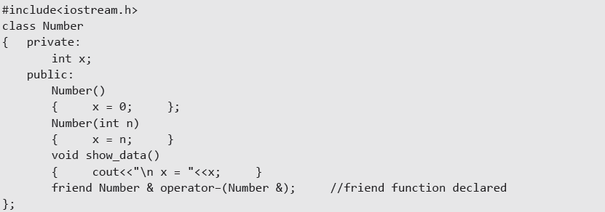
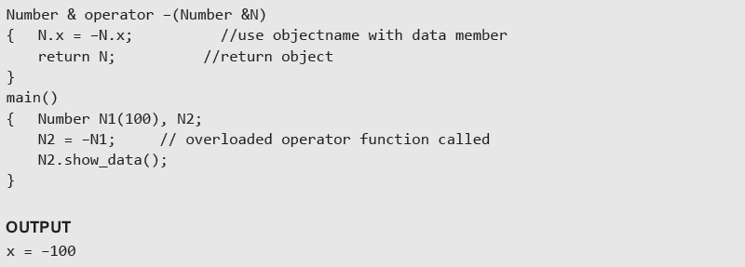
Example:- Use of friend function to overload a unary operator

Slide 18
OVERLOADING BINARY OPERATORS
Binary means two and binary operators mean operators that work with two operands. Like unary
operators, binary operators such as +, −, *, /, =, <. >, !, %, ^, &&, ||, <<, and >> can also be overloaded.
The syntax of overloading a binary operator using a member function can be given as :
return_type operator op(arguments)
The syntax to overload a binary operator using a friend function is :
friendreturn_type operator op(arg1, arg2)

Slide 19
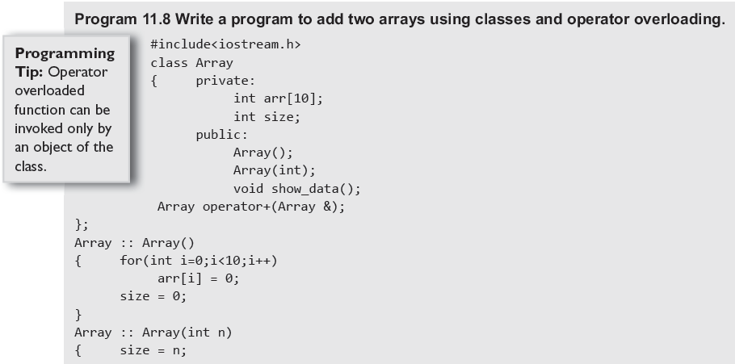
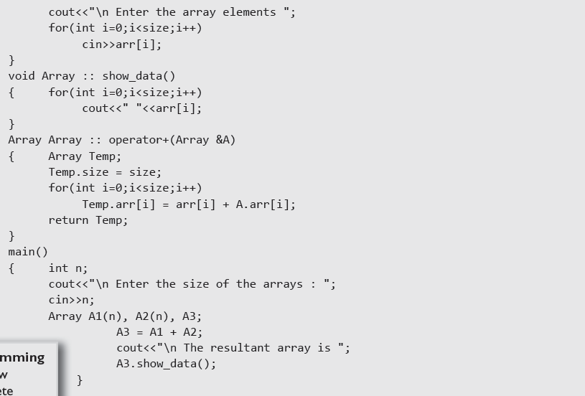

Slide 20
Overloading New and Delete Operators
To allow users to allocate memory in a customized way.
To allow users to debug the program and keep track of memory allocation and de-allocation in their programs.
To allow users to perform additional operations while allocating or de-allocating memory.
The syntax for overloading the new operator can be given as follows:
void* operator new(size_t size);
size_t , which specifies the number of bytes of memory to be allocated.
The return type of the overloaded new must be void* . The overloaded function returns a pointer to the beginning of the block of memory allocated.

Slide 21

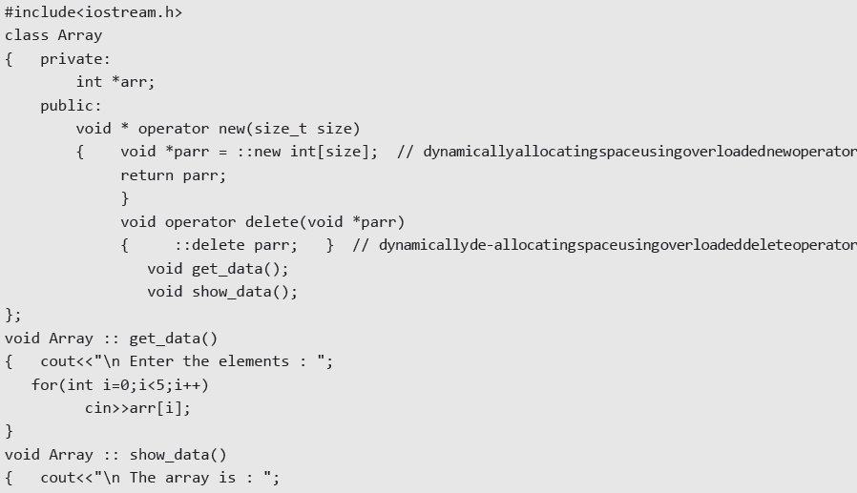
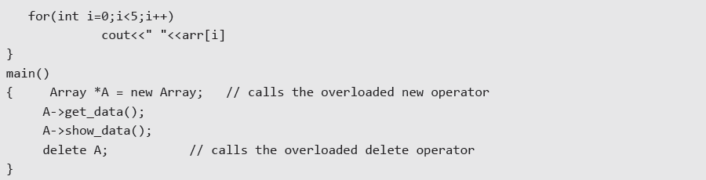

Slide 22
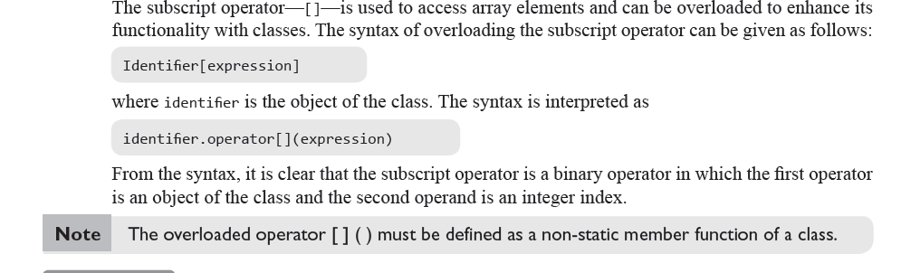
Overloading [] operator

Slide 23
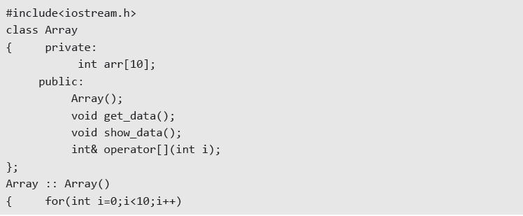
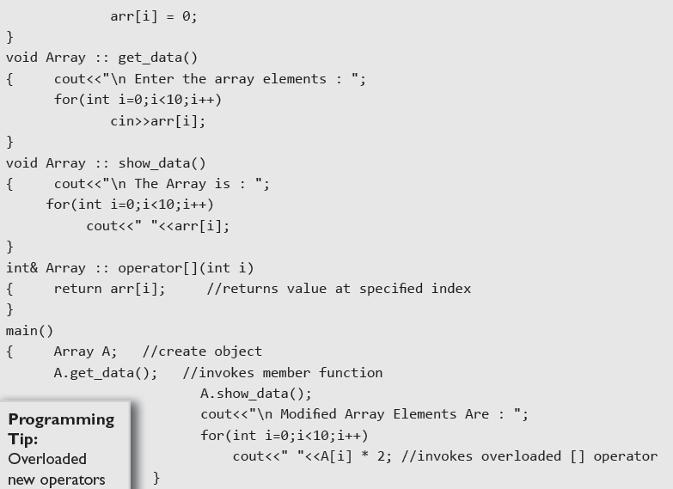

Slide 24
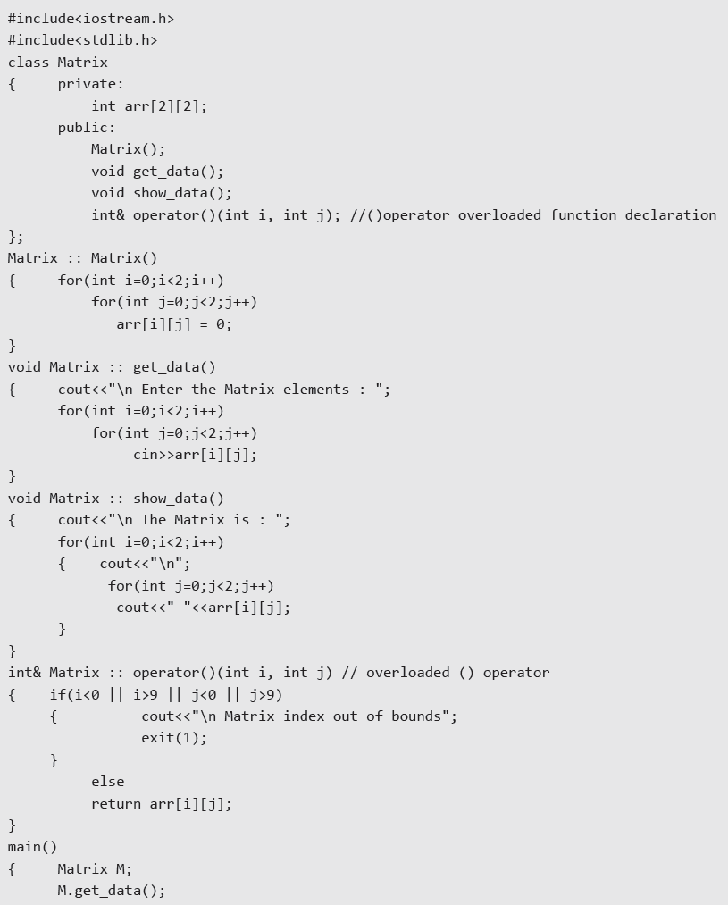
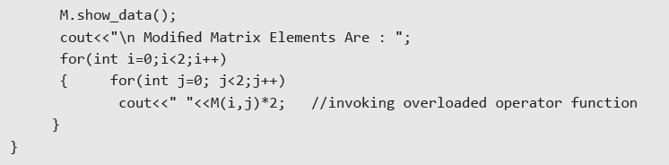
Overloading () for a two-dimensional matrix

Slide 25

Overloading Class Member Access Operator ( -> )
C++ allows programmers to control class member access by overloading the member access operator (>).
The -> operator is a unary operator as it takes only one operand, that is the object of the class. The syntax for overloading the -> operator can be given as,
where class_ptr is a pointer of class type.
Before overloading the class member access operator, the overloaded -> operator function must be a non-static member function of the class.

Slide 26
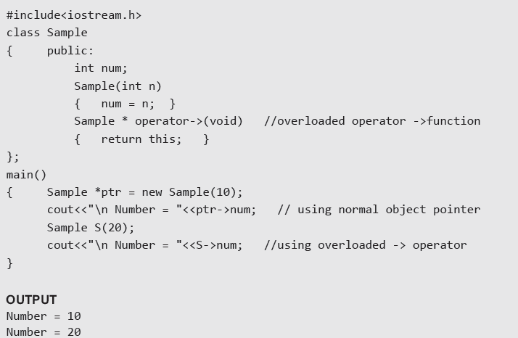
Example

Slide 27

Overloading Input and Output Operators
cin and cout are defined in class iostream.
While cin is an object of istream class, cout is an object of the ostream class. We will read more on the relationship between istream, ostream, iostream, cin, and cout later in chapter File Handling.
The insertion and extraction of operators will be overloaded by using a friend function because we need to call these functions without any object.The insertion and extraction operators must return the value of the left operand.
The ostream or istream object—so that multiple << or >> operators may be used in the same statement. The syntax for overloading the >> function can be given as

Slide 28
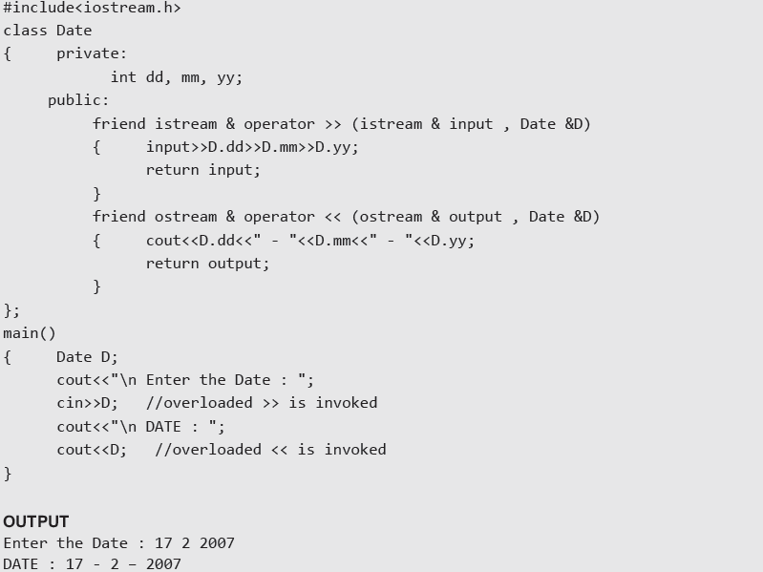

Slide 29



Conversion from Basic to Class Type

Slide 30


Conversion from Class to Basic Data Type
The function can be declared and/or defined within the class.
The function converts the class type into the type_name . For example, operator int() will convert a class type to int .
The function does not have any return type.
The function does not take any argument.
The casting operator is a unary operator that takes just one argument that is the object of the class that invokes this function.

Slide 31
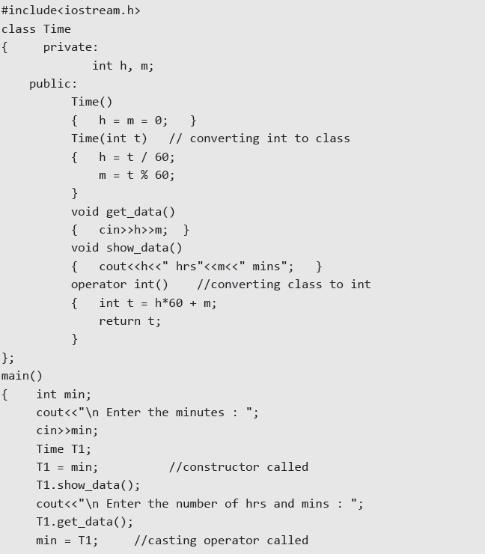


Slide 32


Conversion from Class to Class Type
When performing conversion in the source class, a typecast operator is used. The syntax of such an operator function can be given as
where operator is the keyword and typename may be a built-in or user-defined type. typename usually refers to the destination type.

Slide 33
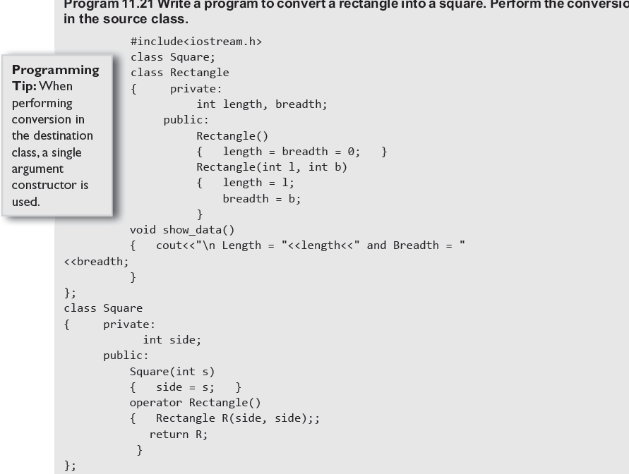
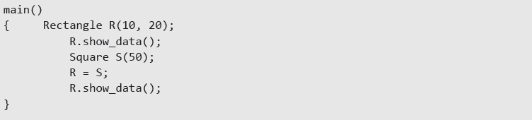

Slide 34
Conversion in Destination Class
When performing conversion in the destination class, a single argument constructor is used.
The argument is an object of the source class which is passed to the destination class for conversion.
The syntax for such a constructor function can be given as

Slide 35
